Slide 1
The Intel Microprocessors
8086/8088, 80186/80188, 80286, 80386, 80486,
Pentium, Pentium Pro Processor, Pentium Ⅱ, Pentium Ⅲ, Pentium 4, and Core2 with 64-Bit Extensions
Architecture, Programming, and Interfacing.
Barry B. Brey

Slide 2
Chapter
1. Introduction to the Microprocessor & Computer
history, operation, methods used to store data in μ based system
2. The Microprocessor and its Architecture
programming model
3. Addressing Modes 4. Data Movement Instructions
5. Arithmetic and Logic Instructions
6. Program Control Instructions
7. Programming the Microprocessor
application using assembler program
8. Using Assembly Languages
use of C/C++ with in-line assembler

Slide 3
Chapter 1
Introduction to the Microprocessor and Computer

Slide 4
Introduction
Overview of the Intel family Microprocessors
History of computers
Function of the microprocessor
Terms and Jargon – computer
Microprocessor-based Personal Computer system
Block diagram and description of function of each block
How the memory and I/O system of PC function
The way that data are stored in the memory
Numeric data : integers, floating-point, BCD
Alphanumeric : ASCII

Slide 5
Chapter Objective
1. computer terminology such as bit, byte, , data, real memory system, EMS, XMS, DOS, BIOS, I/O, and so forth
2. briefly detail the history of computers
3. overview of various 80X86, Pentium-Pentium 4 family
4. block diagram of computer system and its function
5. function of microprocessor and its basic operation
6. define contents of memory system in PC
7. convert between binary, decimal, and hexadecimal numbers
8. differentiate and represent numeric and alphabetic information as integer, floating-point, BCD, and ASCII data

Slide 6
1-1 A historical Background
The mechanical age
abacus : 500 B.C.
calculator(with gears and wheels) : Pascal
The Electrical age
Hollerith machine(1889):12-bit code on punched card
ENIAC(Electronics Numerical Integrator and Calculator) :
1946, Moore school of EE at Univ. of Pennsylvania
first general-purpose, programmable electronic computer
17,000 vacuum tube, 500 miles of wire, 6000 switches
about 100,000 operations per second, 30 tons
hardware programmable : rewiring, switching
life of vacuum tube(3000 hours) : maintenance

Slide 7
Stored Program concept(machines): Dr. John von Neumann
program instruction should be stored in memory unit, just like the data
EDVAC(Electronic Discrete Variable Automatic Computer):1952
UNIVAC(Universal Automatic Computer) :
delivered to Bureau of Census(1951), CBS(1952)
Bipolar Transistor : 1948 by William Shockley, John Bardeen, Walter H. Brattain at Bell labs(1956, Novel physics award)
2nd-Generation Computer : TR
IBM : 7070/7090(1958), 1401(1959)
mainframe : describe CPU portion of computer
mainframe computer : designed to handle large volumes of data while serving hundreds of users simultaneously
built on circuit boards mounted into rack panels(frame)

Slide 8
Integrated Circuit : 1958 by Jack Kilby of Texas Instruments and Dr. Robert Noyce of Fairchild Semiconductor
digital IC(RTL, register-to-transistor logic) : in the 1960s
3rd-Generation Computer : IC
IBM : 32-bit 360 series(1964)
minicomputer : low-cost, scaled-down mainframe
DEC : PDP-8(Programmed Data Processor)
INTEL(Integrated Electronics) : 1968
Robert Noyce and Gorden Moore
4000 family : 1971.11.15
4001 : 2K ROM with 4-bit I/O port
4002 : 320-bit RAM with 4-bit output port
4003 : 10-bit serial-in parallel-out shift register
4004 : 4-bit processor

Slide 9
Programming Advancements
machine language – binary code
assembly language – mnemonic code : UNIVAC
high-level programming language
FLOW-MATIC : 1957 by Grace Hopper
FORTRAN(FORMular TRANslator) : 1957, IBM
COBOL(Computer Business Oriented Language)
RPG(Report Program Generator)
BASIC, C/C++, PASCAL, ADA
Visual BASIC

Slide 10
The microprocessor age
4004(1971, world’s 1st) : 4-bit, P-channel MOSFET technology
4096 4-bit(nibble) wide memory, 45 instructions, 50KIPs
8008(1972, extended 8-bit version of 4004, 16Kbytes)
8080(1973, 1st modern 8-bit) :
2.0×10⁻⁶sec, TTL-compatible, 64K bytes memory
one of 1st Microcomputer : MITS Altair 8800, Kit, 1975
8085(1977, 1.3μs, internal clock generator & system controller)
The modern microprocessor
16-bit : 8086(1978), 8088(1979)
IBM sold the idea of a Personal Computer : 1981.8, 8088
32-bit : 80386, 80486
64-bit : pentium ~

Slide 11
Microcontroller : hidden computer, one chip microcomputer
a microprocessor with on-chip memory and I/O
Supercomputer :
most powerful computer available at any given time
Cray-1 : ECL, 130 MFLOPS(millions of floating-point operations per second)
Parallel Processor : Gigaflops(GFLOPS)
hypercube : arrangement of processors in the form of an n-dimensional cube
DSP(Digital Signal Processor) :
perform complex mathematical computations on converted analog data

Slide 12
RISC(Reduced Instruction Set Computer)
a small(<128) no. of instructions
CISC(Complex Instruction Set Computer)
a large no. of variable length instructions
multiple addressing modes
a small no. of internal processor registers
instructions that require multiple no. of clock cycle to execute
Intel’s i860 RISC processor(Cray on a chip)
82 instructions, each 32 bits in length
four addressing modes
32 general-purpose registers
all instructions execute in one clock cycle

Slide 13
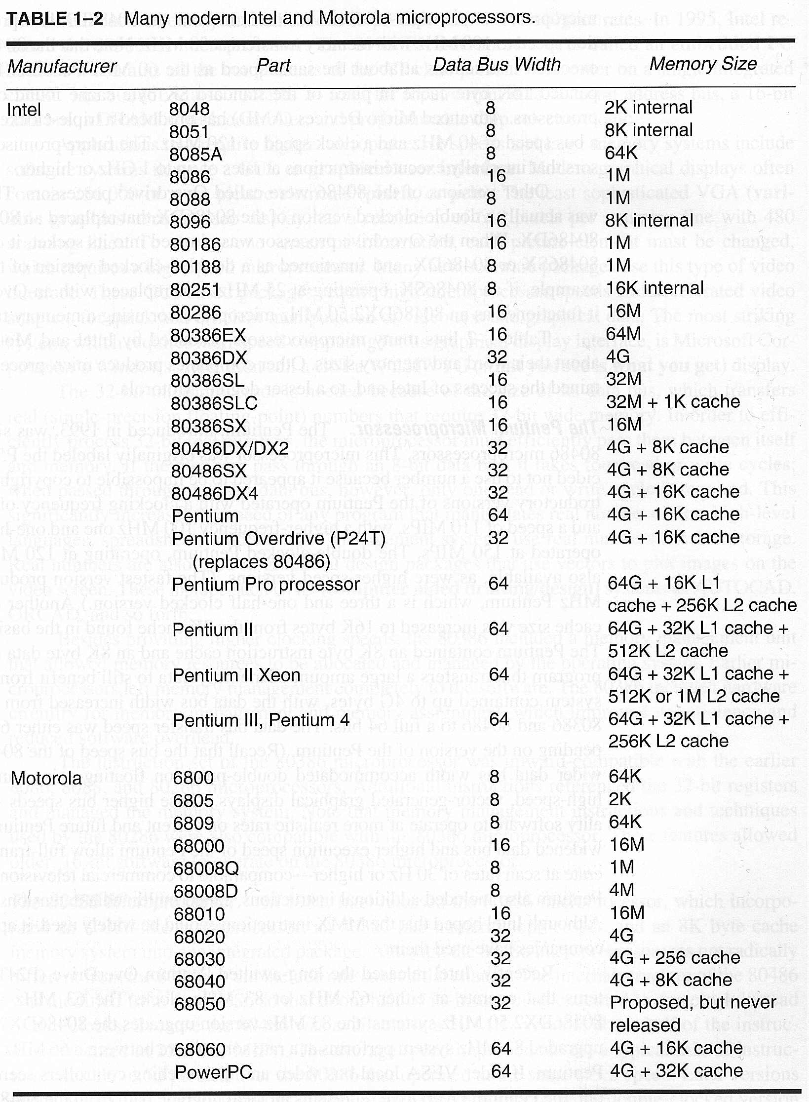
|
|
|
|
|
|

Slide 14
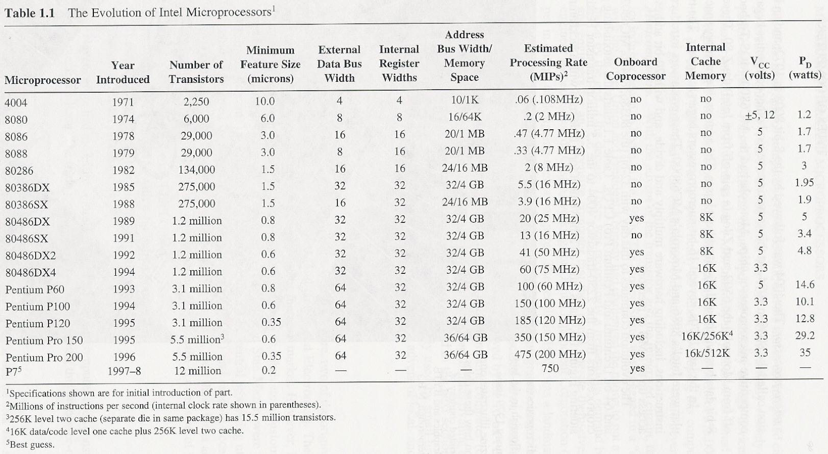

Slide 15
8086 (1978)
20-bit address bus : 1M byte(1024Kbytes) memory
instruction : over 20,000 variation
4004 : 45, 8085 : 246
A separate BIU and EU
Fetch and Execute instruction simultaneously
16-bit Internal processor registers
with the ability to access the high and low 8 bits separately if desired
hardware multiply and divide built in
support for an external math coprocessor
perform floating-point math operations as much as 100 times faster than the processor alone via software emulation

Slide 16
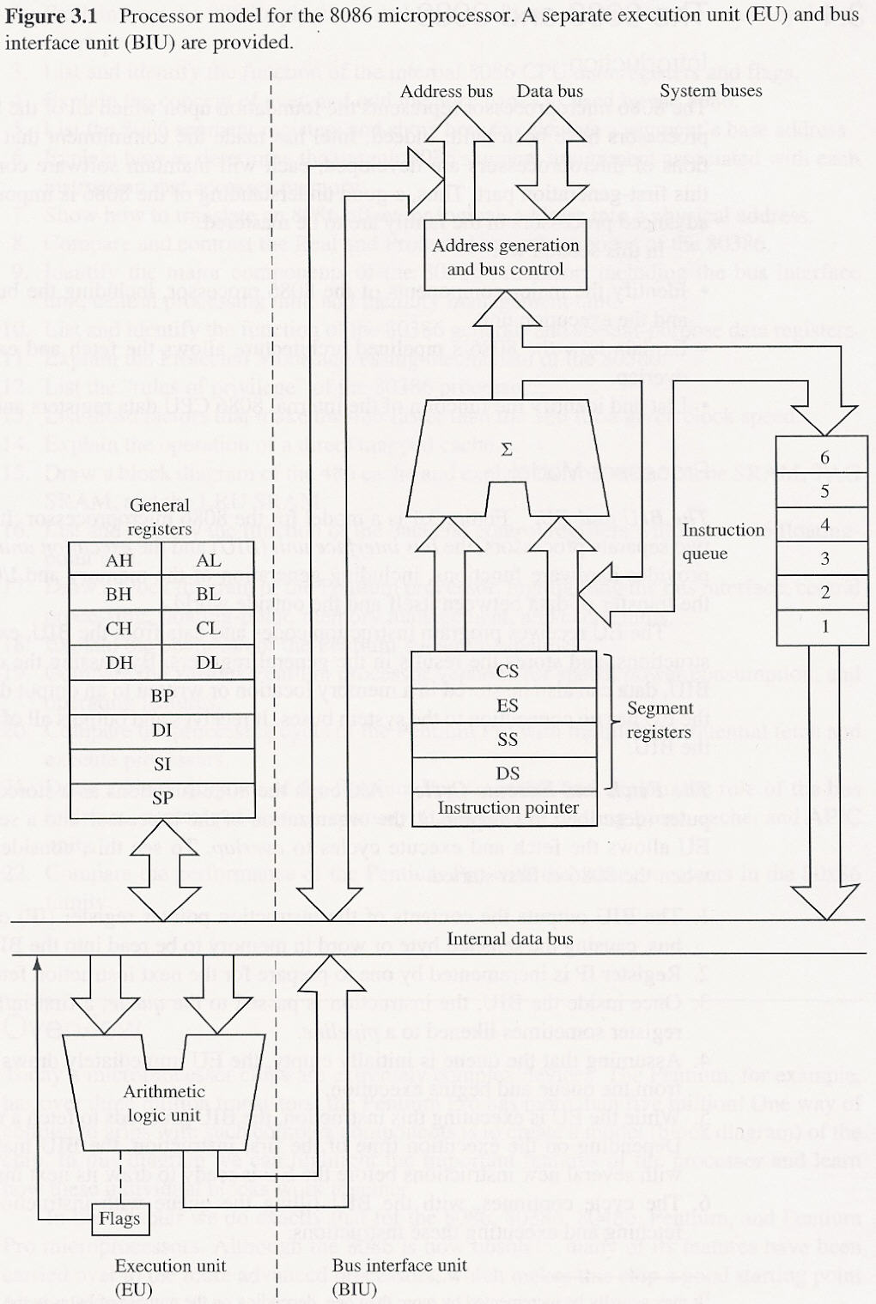
Notes:
Processor model for the 8086 microprocessor

Slide 17
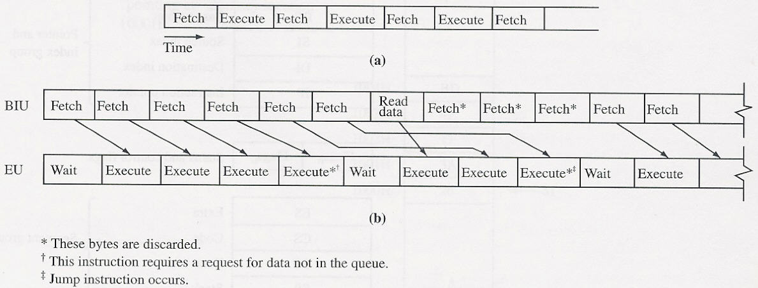

Slide 18
8088
8086(1978) : 16-bit data bus
requirement of two separate 8-bit memory banks to supply its 16-bit data bus
quite expensive memory chip at the time
8088(1979) : external 8-bit data bus
IBM announced the PC : 1981.8
8088, 16K memory(expandable 64K), 4.77MHz(clock speed)
PC standard

Slide 19
80186/80188
High-Integration CPUs
schematic diagram for IBM’s original PC
8088 microprocessor
several additional chips are required
80186 = 8086 + several additional chips
added 9 new instructions
clock generator
programmable timer
programmable interrupt controller
circuitry to select the I/O devices

Slide 20
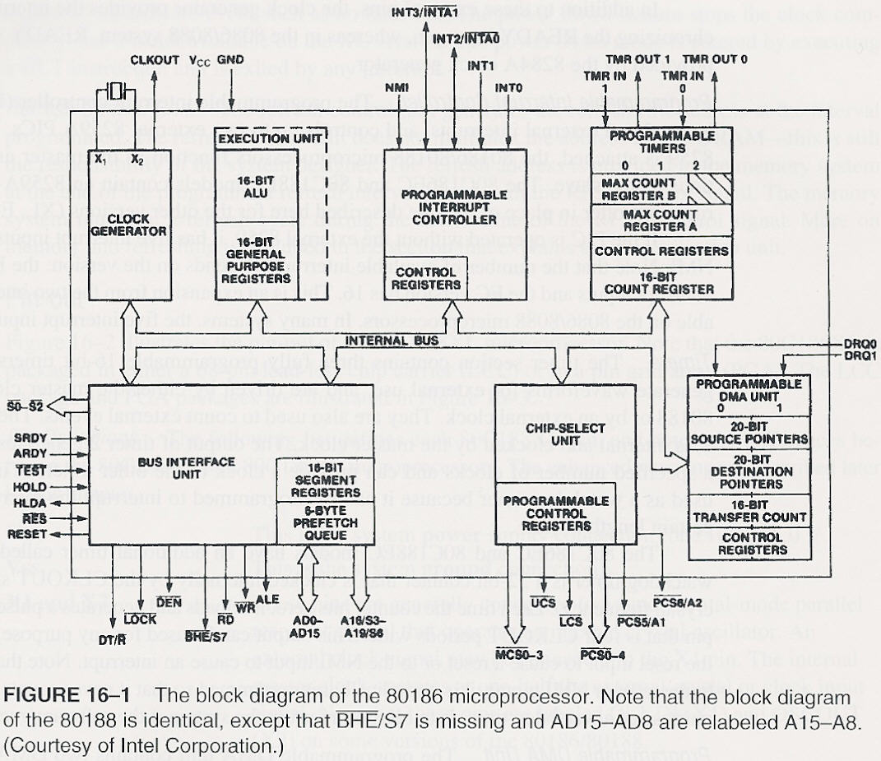

Slide 21
80286 (1982)
some instruction executed : 250ns(4.0MIPS) at 8MHz
24-bit address bus : 16M byte memory
added 16 new instructions
Real Mode: 1st powered on
functions exactly like an 8086
uses only its 20 least significant address lines(1M)
Protected :
A “Fatal Flaw” ?
once switched to Protected mode, should not be able to switch back to Real mode
286 chips are operated in Real mode and thus function only as fast 8086s
IBM AT(advanced technology) Computer :1984

Slide 22
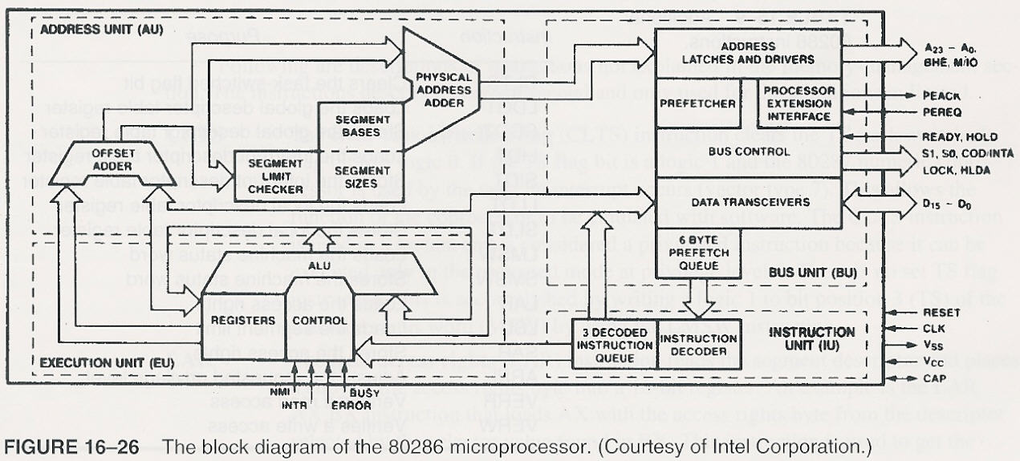

Slide 23
80386
flexible 32-bit Microprocessor(1986) : data bus, registers
very large address space : 32-bit address bus(4G byte physical)
64 terabyte virtual
4G maximum segment size
integrated memory management unit
virtual memory support, optional on-chip paging
4 levels of protection
added 16 new instructions
Real Mode, Protected mode
Virtual 8086 mode : in a protected and paged system
386SX : 16-bit external data bus, 24-bit address bus
386EX : 16-bit external data bus, 26-bit address bus
1995, called embedded PC

Slide 24
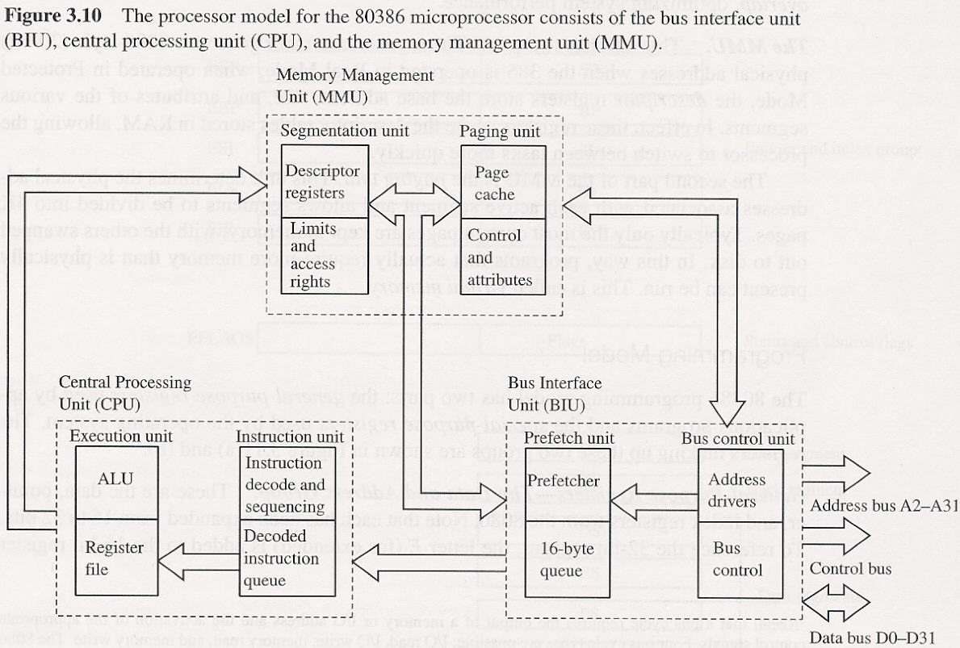

Slide 25
80486
Intel released 80486 in 1989
maintaining compatibility : standard(8086,286,386)
polished & refined 386 : twice as fast as 386
redesigned using RISC concept :
frequently used instruction : a single clock cycle
new 5-stage execution pipeline
highly integrated
8K memory cache
floating-point processor(equivalent of the external 387)
added 6 new instructions : for used by OS

Slide 26
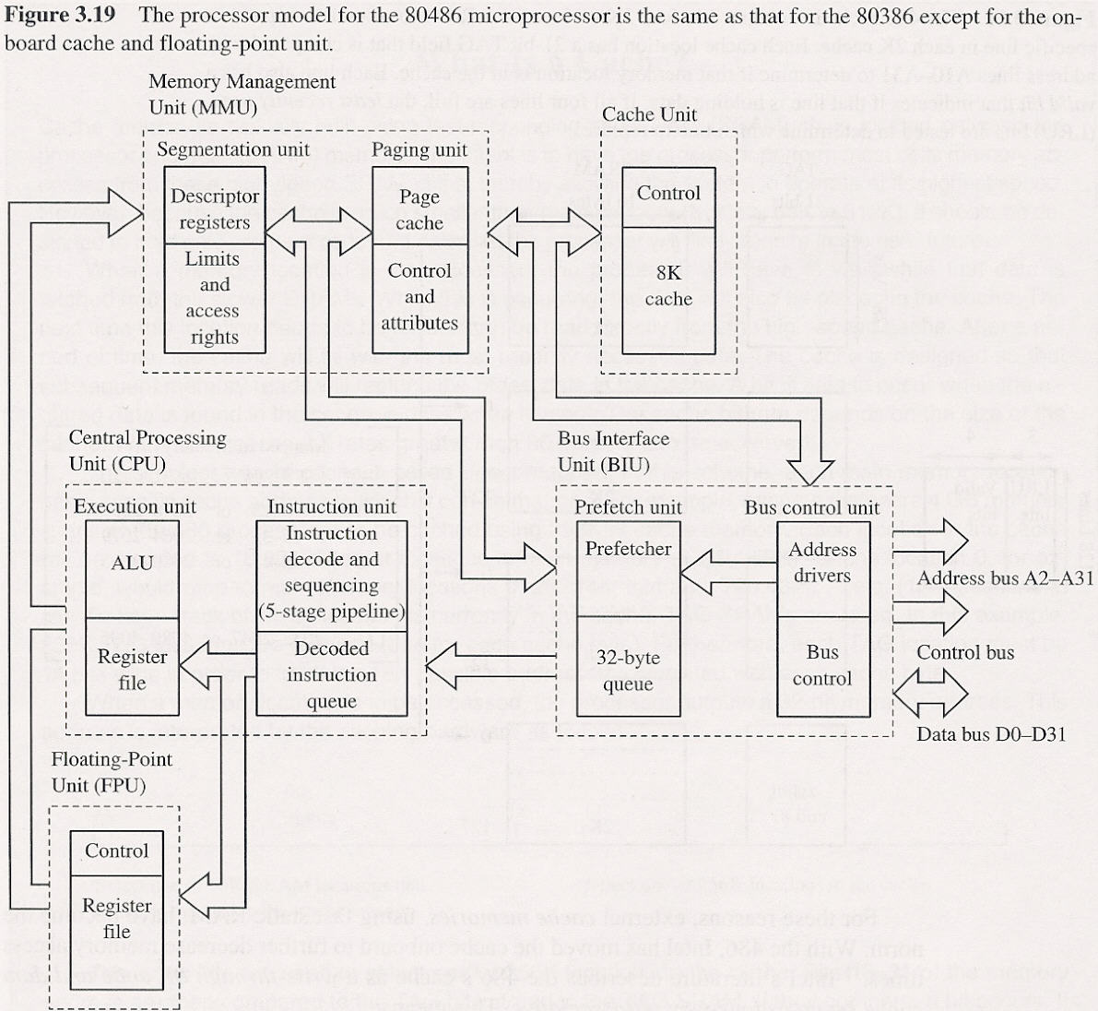

Slide 27
80486
486SX :
for low-end applications that do not require a coprocessor or internal cache
clock speed limited 33MHz
486DX2 & DX4 :
internal clock rate is twice or 3 times external clock rate
486DX4 100 : internal 100MHz, external 33MHz
Overdrive Processor:
486DX2 or DX4 chips with overdrive socket pin-outs
to upgrade low-speed 486DX, SX with 486DX2, DX4

Slide 28
Pentium
increasing the complexity of the IC: to scale the chip down
if every line could be shrunk in half, same circuit could be built in one-forth the area
Superscaler : support 2 instruction pipelines(5 stage)
ALU, address generation circuit, data cache interface
actually execute two different instruction simultaneously
Pentium(1993) : originally labeled P5(80586)
60, 66MHz(110MIPS)
8K code cache, 8K data cache
coprocessor : redesign(8-stage instruction pipeline)
external data bus : 64 bit(higher data transfer rates)
added 6 new instructions : for used by OS

Slide 29
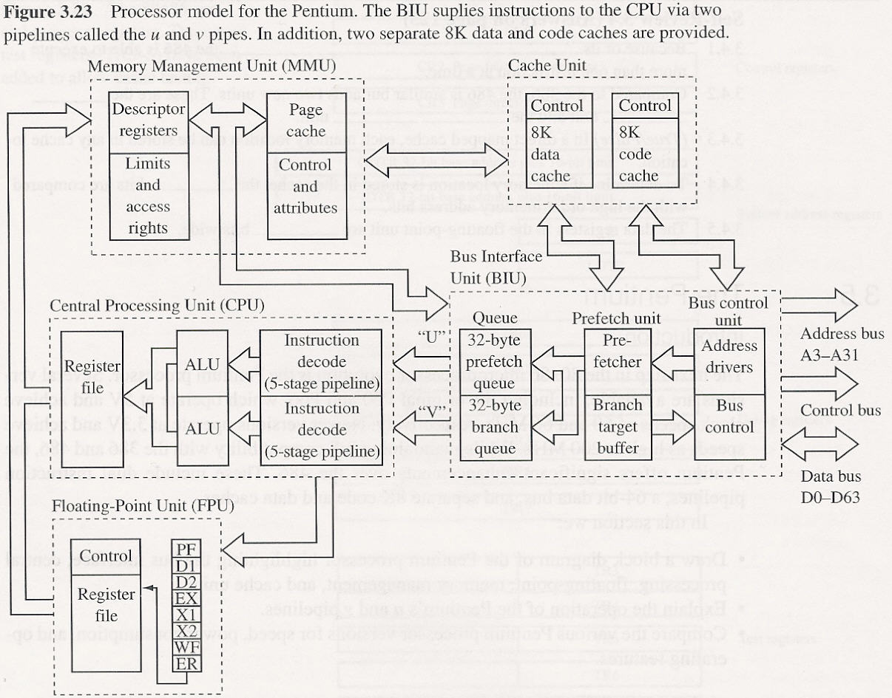

Slide 30
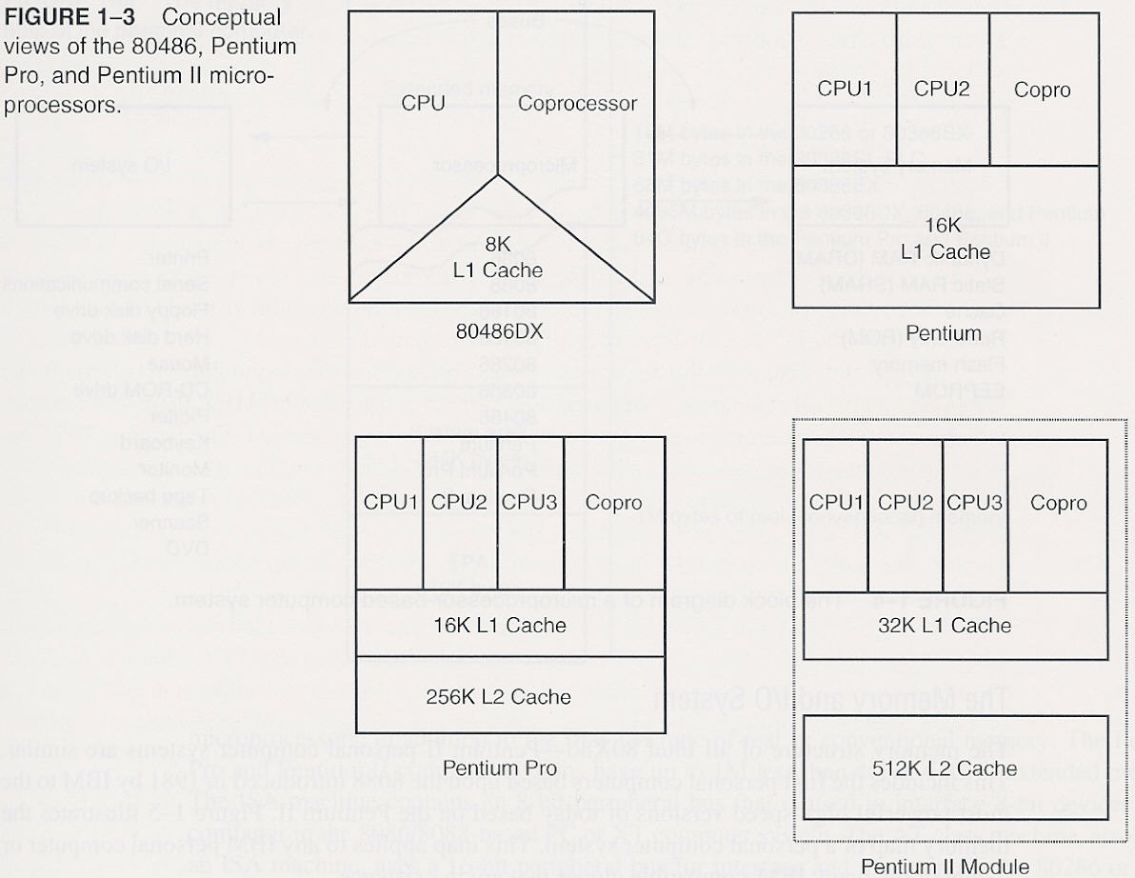

Slide 31
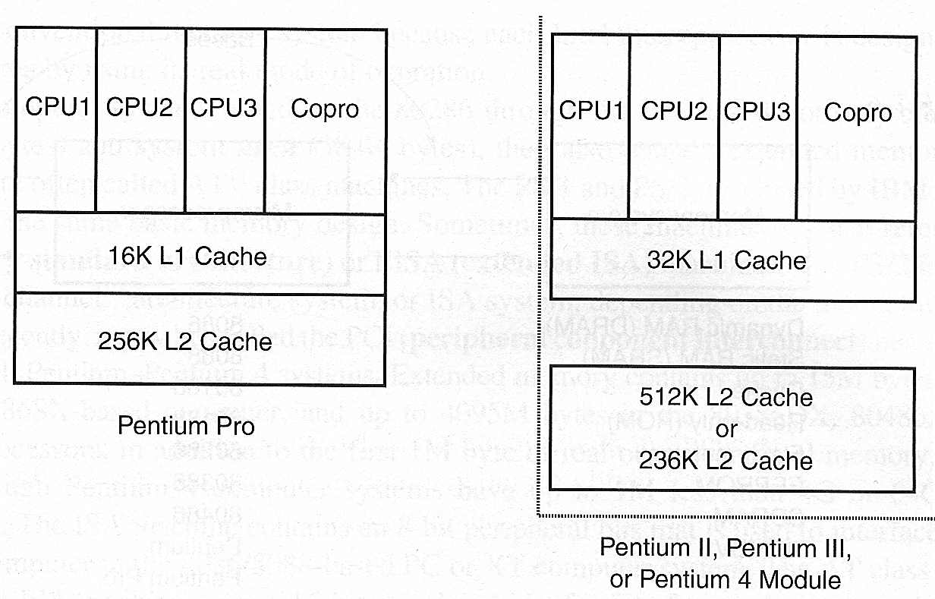

Slide 32
Pentium pro
codenamed P6 : 1995
basic clock frequency : 150, 166MHz
two chips in one : two separate silicon die
processor(large chip), 256K level two cache
Superscaler processor of degree three(12 stage)
internal cache :
level one(L1) : 8K instruction and data cache
level two(L2) : 256K(or 512K)
36-bit address bus : 64G byte memory
has been optimized to efficiently execute 32-bit code
bundled with Windows NT : server market

Slide 33
PentiumⅡand PentiumⅡXeon Microprocessor
PentiumⅡmicroprocessor released in 1997
PentiumⅡ module : small circuit board
Pentium pro with MMX : no internal L2 cache
512K L2 cache(operated at speed of 133MHz)
main reason :
L2 cache found main board of Pentium : 60, 66MHz
not fast enough to justify a new microprocessor
Pentium pro : not well yield
266~333MHz with 100MHz bus speed : in 1998
bottleneck : external bus speed 66MHz
use of 8ns SDRAM :

Slide 34
PentiumⅡand PentiumⅡXeon Microprocessor
new version of PentiumⅡcalled Xeon : mid-1998
for high-end workstation and server applications
main difference from PentiumⅡ :
L1 cache size : 32K bytes
L2 cache size : 512K, 1M, 2M
change in Intel’s strategy :
professional version and home/business version of PentiumⅡ microprocessor

Slide 35
Pentium Ⅲ Microprocessor
1. used faster core than PentiumⅡ
is still P6 or Pentium pro processor
2. Two version :
bus speed : 100MHz
1. slot 1 version mounted on a plastic cartridge
512K cache : one-half the clock speed
2. socket 370 version called flip-chip : looks like the older Pentium package → Intel claim cost less
256K cache : clock speed
3. clock frequency : 1 GHz

Slide 36
Pentium 4 Microprocessor
release in late 2000 : used Intel P6 architecture
main difference :
1. clock speed : 1.3, 1.4, 1.5 GHz
2. support to use RAMBUS memory technology
DDR(double-data-rate) SDRAM : both edge
3. interconnection : from aluminum to copper
copper : is better conductor → increase clock frequency
bus speed : from current max. of 133MHz to 200MHz or higher

Slide 37
The Future of Microprocessors
no one can really make accurate prediction :
success of Intel family should continue for quite a few years
what may occur is : will occur
a change to RISC technology,
but more likely a change to a new technology being developed jointly by Intel and Hewlett-Packard
new technology :
even will embody CISC instruction set of 80X86 family μ,
so that software for system will survive
basic premise behind this technology : many μ
will communicate directly with each other, allowing parallel processing without any change to instruction set or program

Slide 38
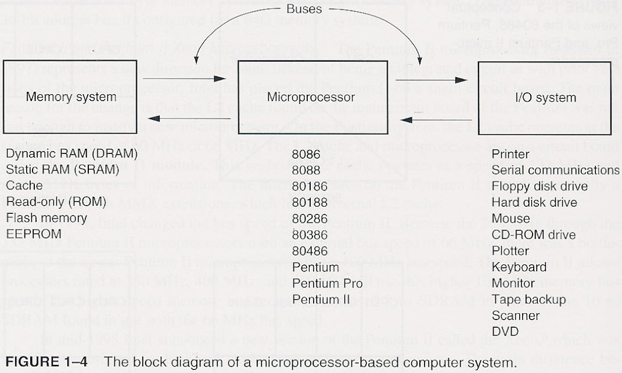
1-2 The microprocessor-based personal computer system
Bus : set of common connection that carry the same type of information(address, data, control)

Slide 39
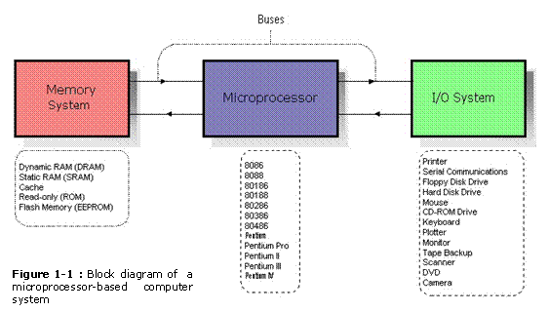
THE MICROPROCESSOR-BASED PERSONAL COMPUTER SYSTEM
Figure 1-1 shows the structure of the microprocessor-based personel computer system. This block diagram also applies to any computer system, from the early mainframe computers to the latest microprocessor-based systems.

Slide 40
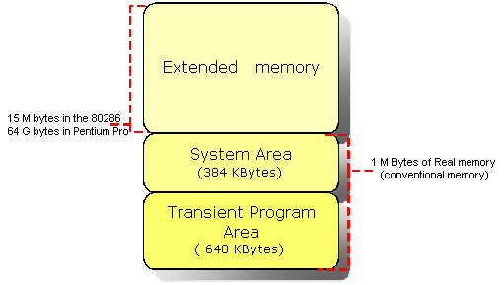
The Memory System
Figure shows block diagram of a memory system The memory system is divided into three parts ;
Transient program area (TPA),
System area and
Extended memory system.
The type of computer determines whether an extended memory system exists. If the computer is based upon an older 8086 or 8088, the TPA and system area exists, but there is no extended memory area. The TPA consists of 640 KB of memory where system area exists in 384 KB. That makes 1024 KB of memory or 1 M byte of memory which is referred as real or conventional memory. ( This is because each Intel microprocessor is designed to function in this area by using its real mode of operation.)
.

Slide 41
1.1.1. Transient Program Area
The transient program area (TPA) holds the DOS operating system and other programs that control the computer. The TPA also stores any currently active or inactive DOS application programs.
BIOS ; ( Basic I/O System )
The system BIOS is a collection of programs stored in either a read-only memory (ROM) or flash-memory that operates many of the I/O devices connected to computer system.
Flash-memory is an EEPROM (electrically erasable read-only memory) that is erased in the system electrically, while the ROM is a device that must be programmed in a special machine called EPROM programmer for an EPROM ( erasable / programmable read-only memory ) or at the factory when ROM is fabricated.
DOS ; ( Disk Operating System )
Controls the way that the disk memory is organized and controlled, as well as the function and control of the some of the I/O devices connected to the system.

Slide 42
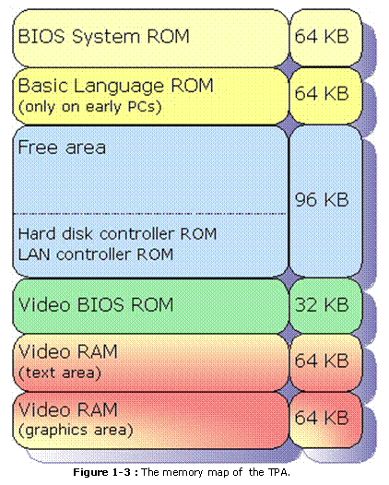
Figure 1-3 shows the TPA (transient program area) of memory system.

Slide 43
1.1.1. Transient Program Area
1. INTERRUPT VECTORS
The interrupt vectors access various features of the DOS and BIOS, and applications.
2. BIOS communications area and DOS communications area
The system BIOS communications area and DOS communications area contain transient data used by programs to access I/O devices and the internal features of the computer system. These are stored in the TPA so that they can be changed as the system operates. (Note that TPA contains read/write (RAM) memory ).
3. IO.SYS
The IO.sys is a program that loads into the TPA from the disk whenever an MSDOS system is started. The io.sys contains programs that allow DOS to use the keyboard, video display, printer, and other I/O devices often found in the computer system. The io.sys program links DOS to the programs stored on the system BIOS ROM.
4. MSDOS PROGRAM
The MSDOS program area occupies twice. One area is 16 bytes in length and is located at the top of the TPA, and the other is much larger and is located near the bottom of the TPA. The DOS program controls the operation of the computer system. The size of the DOS area depends on the version of DOS installed in the computer and how it is installed. If DOS is installed in high memory with HIMEM.SYS driver, most of the TPA is free to hold application programs.

Slide 44
1.1.1. Transient Program Area
5. DRIVER AREA
The size of the driver area and number of drivers change from one computer to another. Drivers are programs that control installable I/O devices such as a mouse, disk cache, scanner, CD-ROM memory, DVD, or installable devices, as well as programs. The driver area varies in size and contains different numbers and types of drivers.
6. COMMAND.COM
The COMMAND.com program (command processor) controls the operation of the computer from the keyboard when operated in the DOS mode. The command.com program processes the DOS commands as they are typed from the keyboard.
7. FREE TPA AREA
The free TPA area holds DOS application programs as they are executed. TPA also holds TSR (terminate and stay resident) programs that remain in memory in an active state until activated by a hot-key sequence or another event such as an interrupt.

Slide 45
1.1.2. The System Area
The system area contains programs on either a read-only memory (ROM) or flash memory (EEPROM), and areas of read/write (RAM) memory for data storage. Figure 1-4 shows the system area of a typical computer system.
The size and amount of memory used in video RAM area depends on the video display adapter attached to the system, such as CGA, EGA, or one of newer forms of VGA.
Generally the video RAM located in first 64 KB memory stores graphical or bit-mapped data, and the second 64 KB memory stores text data.
Note that some newer video cards relocate the memory to wider, higher areas in the memory system for use under Windows operating system.

Slide 46
The video BIOS ROM located on a ROM or flash memory (EEPROM), contains programs that control the DOS video display.
Hard disk controller ROM : If a hard disk memory is attached to the computer, the interface card must contain a ROM and a disk BIOS. This ROM holds low level format software. The size , location, and presence of the ROM depend on the type of hard disk adapter attached to the computer.
Note that most IDE drives do not have this ROM, but many SCSI disk interfaces do contain ROM.

Slide 47
The free area is used for the expanded memory system in a PC system, or for the upper memory system in an AT system. Its use depends on the system and its configuration. The expanded memory system allow a 64 K-byte page frame of memory to be used by application programs.
This 64 K-byte page frame is used to expand memory system by switching in pages of memory from EMS into this range of memory addresses.
Note that the information is addressed şn the page frame as 16 K-byte sized pages of data that are swapped with pages from EMS. Figure 1-5 shows the expanded memory system.
Note that expanded memory is slow because the change to a new 16 K-byte memory page requires action by the driver.
Also note that expanded memory was designed to expand memory system early 8086/8088-based computer systems. In most cases, except for some DOS-based games that use the sound card, expanded memory should be avoided in 80386-Pentium IV- based systems.

Slide 48
Next memory location contain cassette BASIC language on ROM found in early IBM personal computer systems. This area is often open or free in newer computer systems. In newer systems, we often back-fill this area with extra RAM for use by DOS programs, called upper memory. Each upper memory block is 4 K bytes in length.
The system BIOS ROM controls the operation of the basic I/O devices connected to the computer system. It does not control the operation of the video system, which has its own BIOS ROM. The first part of the system BIOS often contains programs that set up the computer. Second part contains procedures that control the basic I/O system. Once the system is set up, upper memory blocks are available is EMM386.EXE is installed.

Slide 49
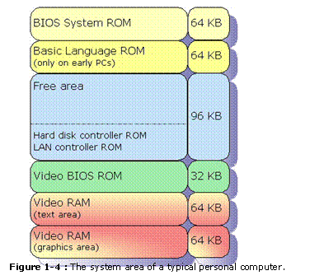
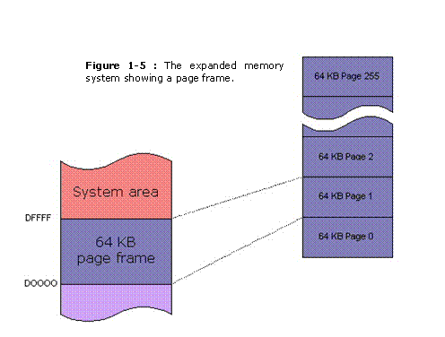

Slide 50
1.2. I/O Space
The I/O (input/output) space is a computer system extends from I/O port 0000H (0) to port FFFFH (65535). This port addressing system is similar to a memory address, except that instead of addressing memory, it addresses an I/O device.
The I/O devices allow the microprocessor to communicate between itself and outside world. The I/O space allows computer to access up to 64 K (65535) different 8-bit I/O devices. A great number of these locations are available for expansion in newer computer systems. Figure 1-6 shows the I/O map found in many personal computers.
The I/O area contains two major sections. The area below I/O location 0400H is considered reserved for system devices. The remaining area is available I/O space for expansion on newer systems that extends from I/O port 0400H (1024) through FFFFH. Some of the mainboards in newer computer systems also use other addresses above 400H. Generally, I/O addresses between 0000H and 00FFH (255) address components on the mainboard of the computer, while addresses between 0100H and 03FFH (1023) addresses devices located on plug-in cards. Note that the limitation of I/O addresses between 0000H and 03FFH comes from the original PC standard.

Slide 51
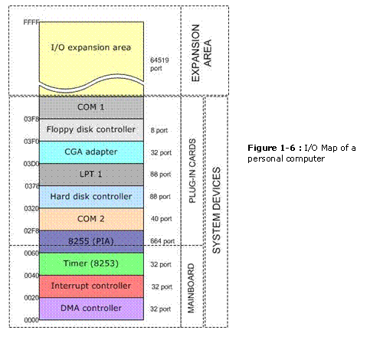

Slide 52
1.3. The Microprocessor
The Microprocessor is the heart of the microprocessor-based computer system. The Microprocessor (CPU) is the controlling element of in a computer system. The microprocessor controls memory and I/O through a series of connection called buses. The buses select an I/O or memory device, transfer data between an I/O device or memory and the microprocessor, and control the I/O and memory system. Memory and I/O are controlled through instructions that are stored in the memory and executed by the microprocessor.
The microprocessor performs three main tasks for the computer system ;
1. data transfer between itself and the memory or I/O systems,
2. simple arithmetic and logic operations, and
3. program flow via simple decisions.

Slide 53
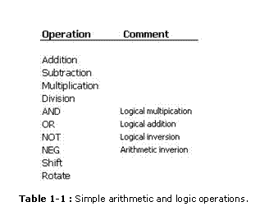
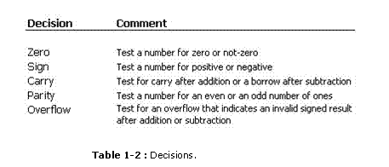
These are simple tasks but the microprocessor performs any series of operations or tasks through them. Table 1-1 shows the arithmetic and logic operations executed by Intel family of microprocessors. Table 1-2 shows the decisions found in microprocessors. Beginning with the 80486, the microprocessor contained a numeric coprocessor that allowed it to perform complex arithmetic using floating-point arithmetic.

Slide 54
1.4. Bus
A bus is set of common connections that carry the same type of information. A bus is a common group of wires that interconnect the sections of a computer system. The buses transfer address, data, and control information between the microprocessor and its memory and I/O systems.
In the microprocessor-based computer system three buses exist for this transfer of information ;
1. Address,
2. Data, and
3. Control.

Slide 55
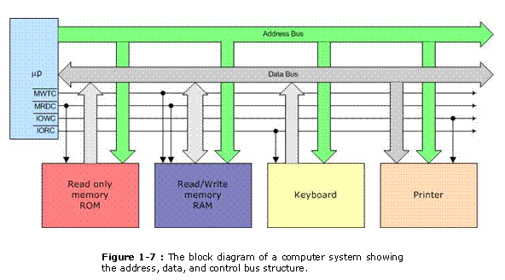
Figure 1-7 shows how these buses interconnect various system components

Slide 56
1.4. Bus
The address bus requests a memory location from the memory or an I/O location from the I/O devices. If I/O is addressed, the address bus contains a 16-bit I/O address from 0000H through FFFFH. The 16-bit I/O address, or port number, selects one of 64K different I/O devices. If memory is addressed, the address bus contains a memory address, which varies in width with the different versions of the microprocessor.
The data bus transfers information between the microprocessor and its memory and I/O address space. Data transfers vary in size, from 8-bits wide to 64 bits wide in various members of microprocessors. The advantage of wider data bus is speed in applications that use wide data. If a 32-bit number stored in the memory, it takes four transfer operations for a 8-bit data bus to complete transfer. A 32-bit wide data bus does the same job with one transfer.
The control bus contains lines that select the memory or I/O and cause them to perform a read or write operation. There are four control bus connections ;
1. memory read control
2. memory write control
3. I/O read control
4. I/O write control

Slide 57
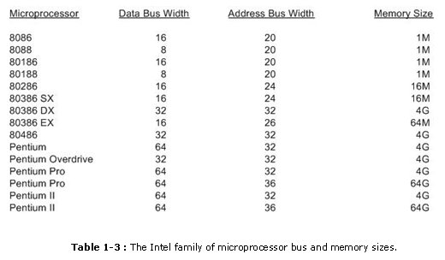
The microprocessor reads the contents of a memory location by sending the memory address through the address bus. Next it sends the memory read control signal ( ) to cause memory to read data. Finally, the data read from the memory are passed to the microprocessor through the data bus. Whenever a memory write, I/O write, or I/O read occurs, the same sequence ensues, except that different control signals are issued and the data flow out of the microprocessor through its data bus for a write operation.

Slide 58
Examples of buses
Examples of buses are as follows ;
· Address Bus ; contains 20 or more connections, conveys the memory address to the memory.
· PCI Bus ( Peripheral Component Interconnect ) ; Used almost in all Pentium II systems.
· VESA Local Bus (VL Bus) ; Interfaces disk and video to the microprocessor at the local bus level, which allows 32-bit interfaces to function at the same clocking speed as the microprocessor.
· USB Bus ( Universal Serial Bus ) ;Intended to connect peripheral devices such as keyboards, a mouse, modems, and sound cards to the microprocessor through a serial data path and a twisted pair of wires. The main idea is to reduce system cost by reducing the number of wires.
· AGP Bus ( Advanced Graphics Port ) ;Transfers data between the video card and the microprocessor at higher speeds, with a 64-bit data path, than were possible through any other bus or connection.

Slide 59
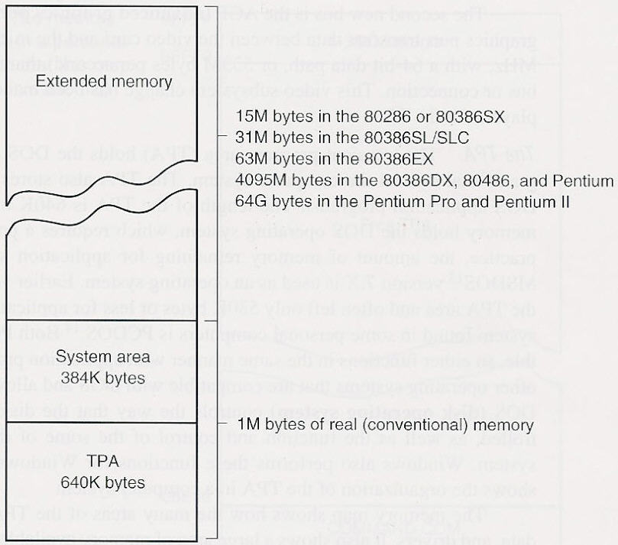
Memory and I/O system Fig. 1-5 The memory map of the personal computer
Expanded Memory (EMS)
XMS( 100000H~)
High Memory Area(HMA, 100000~10FFEFH)
Upper Memory Block (UMB,A0000~100000H )
Transient Program Area (basic memory)

Slide 60
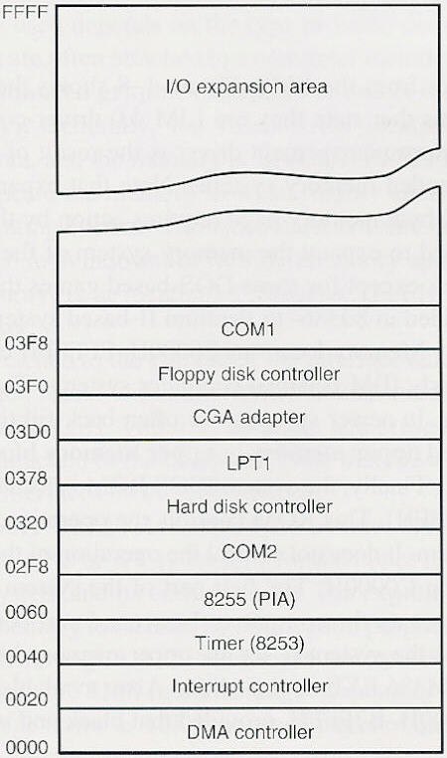
I/O space
Fig. 1-9 I/O map of a PC
I/O space : allows computer to access up to 64K different 8-bit I/O devices
I/O port address: addresses an I/O device
I/O devices : allow microprocessor to communicate between itself and outside world
Two major section
~03FFH : reserved for system devices
~00FFH : components on main board
0100~03FFH : devices located on plug-in cards
0400F~FFFFH : for user

Slide 61
The Microprocessor
µ(Central Processing Unit) : controls memory and I/O through a series of connections called busses
buses : select an I/O and memory device, transfer data between an I/O device or memory and microprocessor, and control the I/O and memory system
memory and I/O : controlled through instructions that are stored in the memory and executed by the microprocessor
performs three main tasks for computer system ;
data transfer between itself and memory or I/O
simple arithmetic and logic operations
program flow via simple decisions
stored program concept(Von Neumann): has made microprocessor and computer system very powerful devices

Slide 62
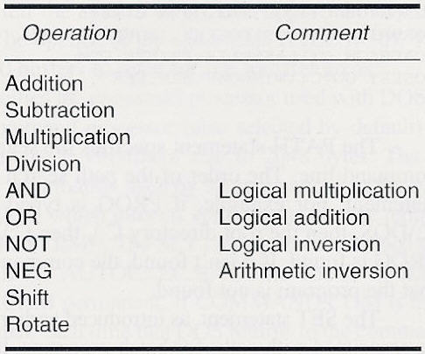
Table 1-3 Simple arithmetic and logic operations
data : are operated upon from memory system or internal registers
data width : byte, word, doubleword
µ : contains numeric coprocessor(from 80486, floating point arithmetic)

Slide 63
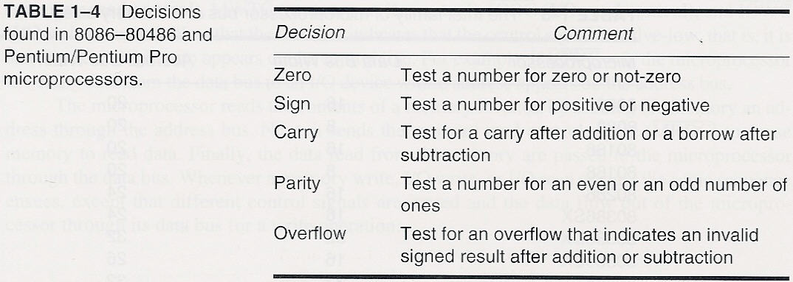
Table 1-4 Decisions

Slide 64
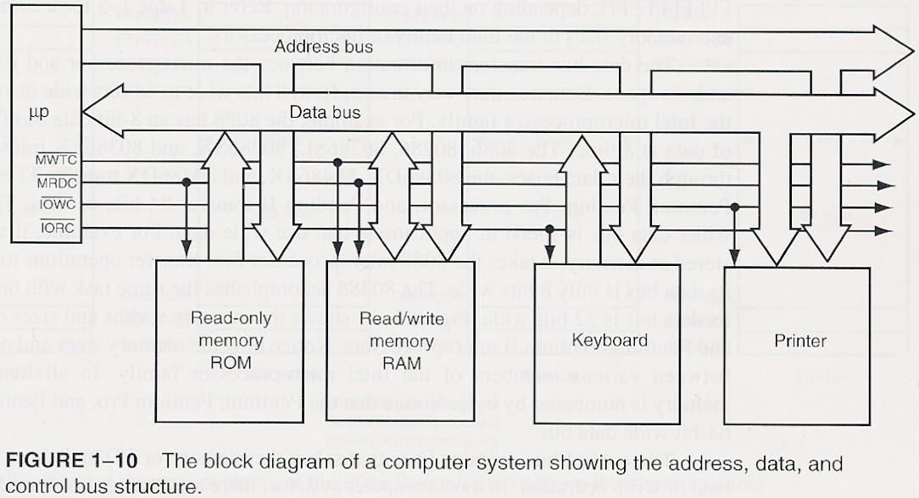
Bus
bus : A common group of wires that interconnect components in a computer system (Fig. 1-10)
Address, Data , Control bus

Slide 65
Bus
address bus : requests a memory location from memory or an I/O location from I/O devices (Fig. 1-10, Table 1-5)
16-bit I/O address(port address, port no.) : 0000~FFFFH
data bus : transfer information between microprocessor and its memory and I/O address space (Fig. 1-10)
advantage(wider data bus) : speed in application that use wide data (Fig. 1-11)
control bus : contains lines that
select the memory and I/O
cause them to perform a read or write operation
MRDC. MWTC, IORC, IOWC
memory read : send memory an address through address bus, send MRDC, read data through data bus

Slide 66
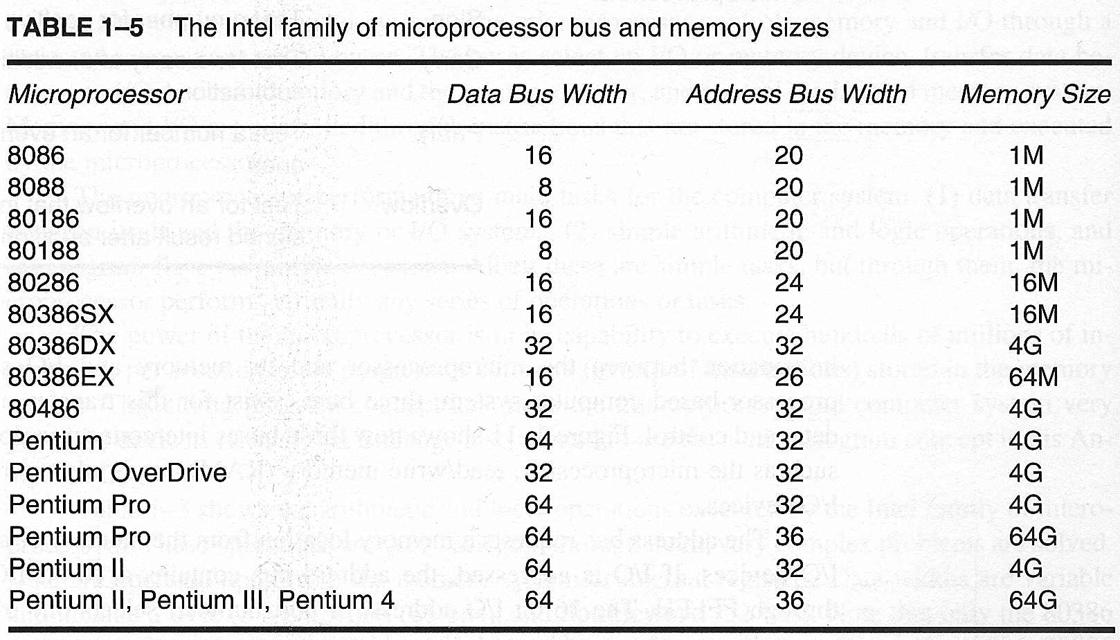

Slide 67
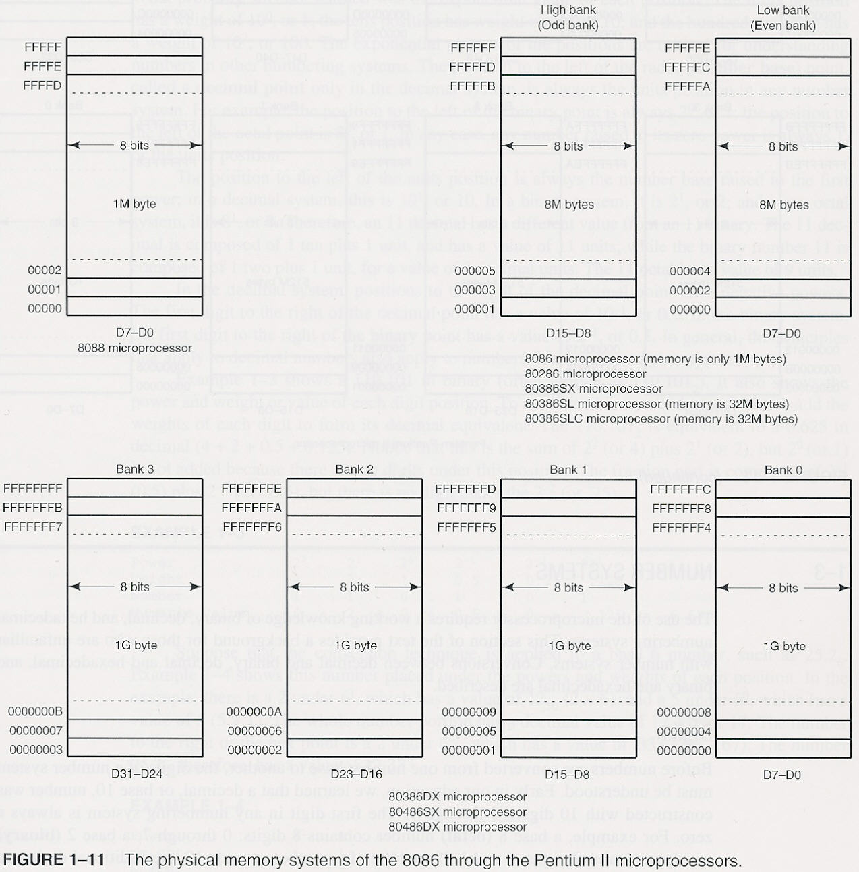

Slide 68
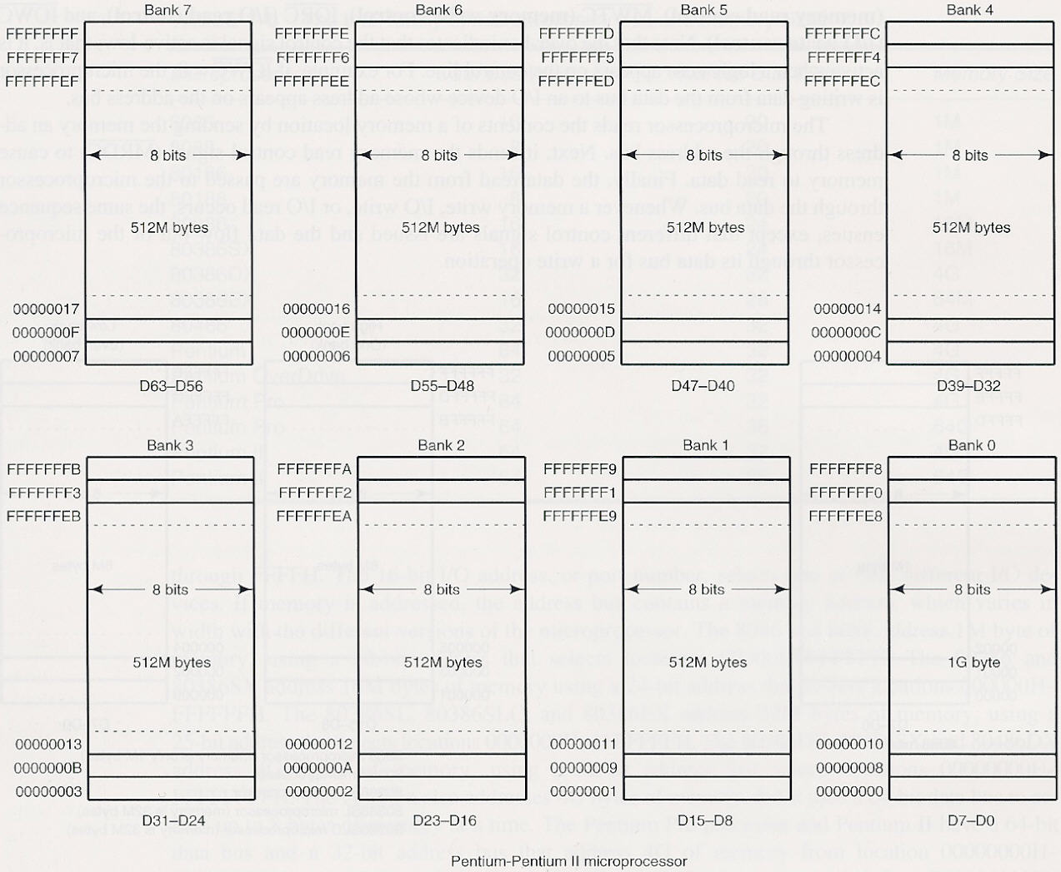

Slide 69
1-3 number systems
digit :
decimal(base 10) : 0 – 9
binary : 0 – 1, octal : 0 – 7, hexadecimal : 0 – 9, A - F
positional notation :
radix(number base) point : decimal point
weight : · · · 10¹(tens position), 10⁰(units), 10⁻¹, · ·
Ex. : 132 = 1×100+3×10+2×1 = 1×10²+3×10¹+2×10⁰
EX. 1-3, 1-4

Slide 70
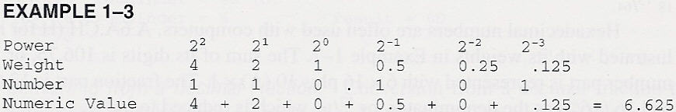
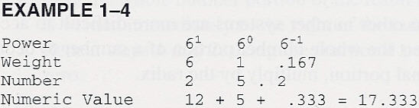
1-3 number systems

Slide 71
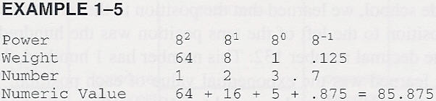
Conversion to Decimal
write down the weights of each position of the number
EX. 1-5, 6, 7

Slide 72
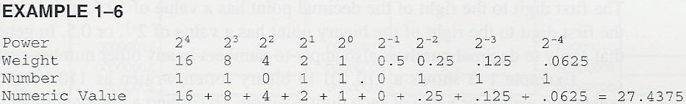
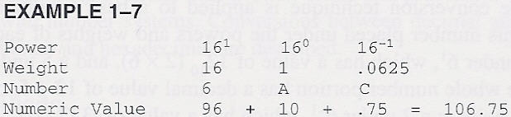
Conversion to Decimal

Slide 73
Conversion from Decimal number
separate into an integer part and a fraction part
conversion from a decimal integer
1. divide by the radix(number base)
2. save the remainder(1st remainder is least significant digit)
3. repeat steps 1 and 2 until the quotient is zero
EX. 1-8, 1-9, 1-10

Slide 74
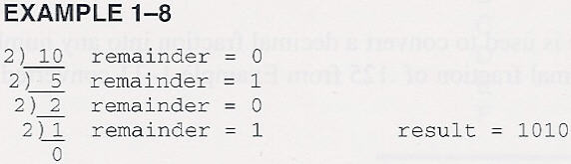
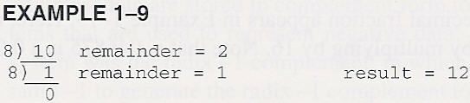
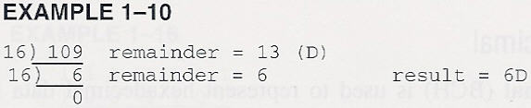

Slide 75
Conversion from Decimal number
conversion from a decimal fraction
1. multiply by the radix(number base)
2. save the whole no. position of the result(even if zero) as a digit. Note that the 1st result is written immediately to the right of the radix point
3. repeat steps 1 and 2 until the fraction part is zero
EX. 1-11, 12, 13

Slide 76
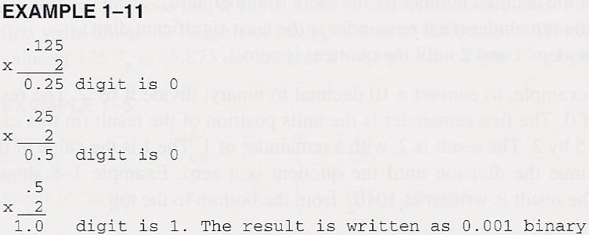
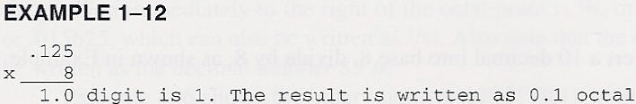
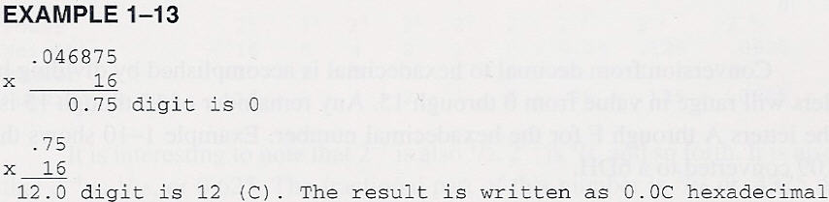

Slide 77
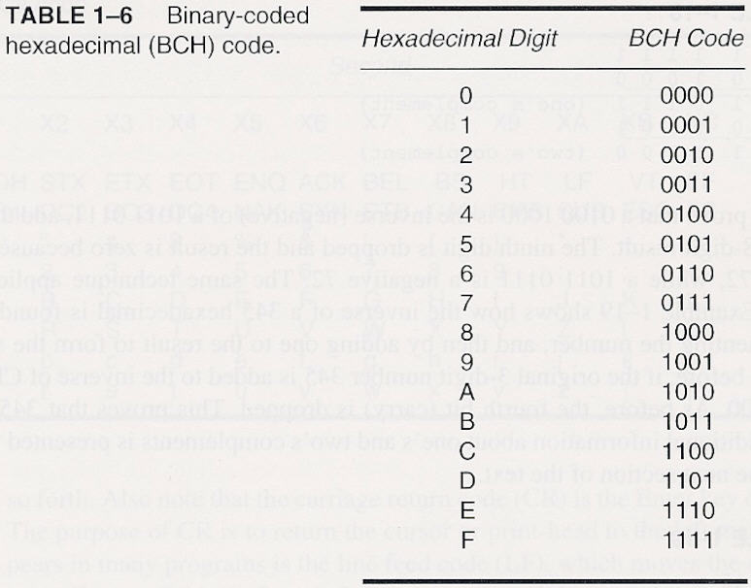
Binary-Coded Hexadecimal
EX. 1-14 : 2AC = 0010 1010 1100
EX. 1-15 : 1000 0011 1101 . 1110 = 83D.E

Slide 78
Complements
Radix(r’s) complement
Radix-1((r-1)’s, diminished radix) complement
Base-r number system No. N(n digit)
r’s : r^{n} – N
(r-1)’s : (r^{n} – 1) – N
Main problem of Radix-1:negative or positive zero
(r-1)’s:
Each digit is subtracted form (r-1)
EX. 1-16, 17

Slide 79
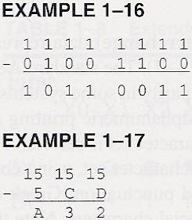
Complements

Slide 80
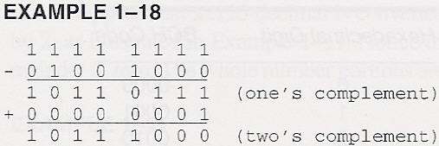
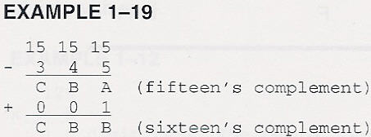
Complements
r’s : EX. 1-19, 20
find (r-1) complement, and then add a one to the result

Slide 81
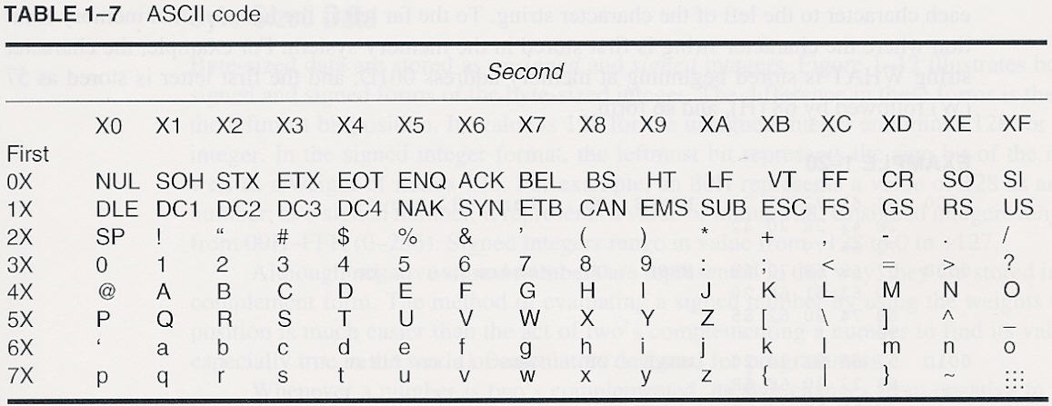
1-4 Computer Data Formats
ASCII, BCD, signed and unsigned integer, real
ASCII(American Standard Code for Information Interchange)
Alphanumeric character, 7-bit code

Slide 82
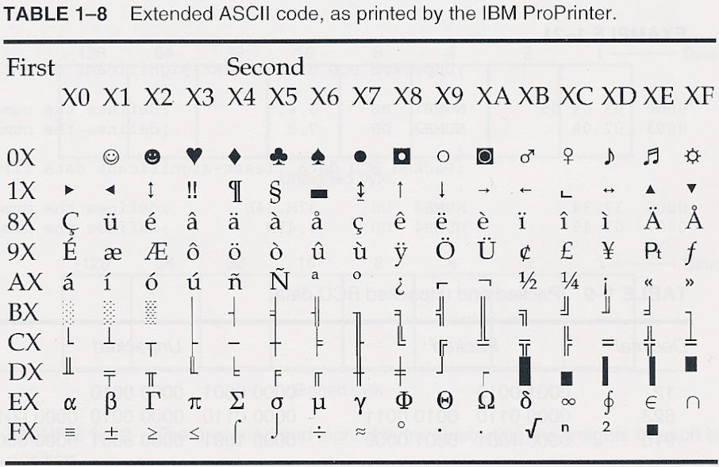
8-bit ASCII code = parity bit + 7-bit ASCII
extended ASCII character set
some foreign letters and punctuation, Greek characters, mathematical characters, box-drawing characters, and other special characters

Slide 83
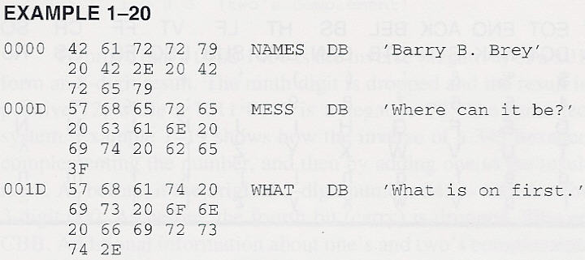
unicode(16-bit) : windows-based application
0000H~00FFH : standard ASCII code
0100H~FFFFH : all world-wide character sets
ASCII data : by using special directive
Define Byte(s):DB, BYTE – surrounded by apostrophes(‘)

Slide 84
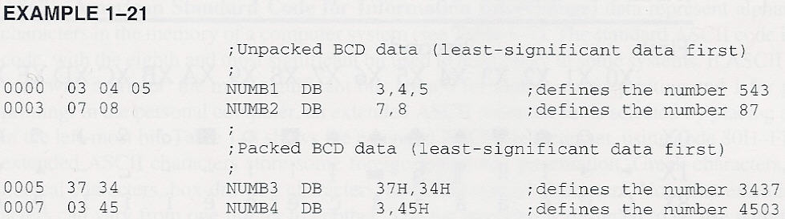
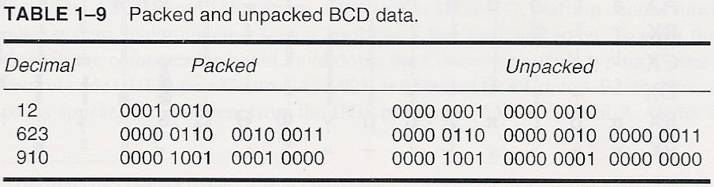
Binary-Coded Decimal(BCD) Data
packed BCD data : stored as two digits per byte
unpacked BCD : stored as one digit per byte

Slide 85

Byte-Sized Data
unsigned and signed integers
unsigned no. : 0 ~ 255(00H ~ FFH)
signed no. : -128 ~ +127(80H ~ 7FH)

Slide 86


Byte-Sized Data

Slide 87

Byte-Sized Data

Slide 88

Word-Sized Data
little endian : least significant byte – lowest-no. memory
big endian

Slide 89

Word-Sized Data
signed and unsigned word-sized data
define word(s) directive : DW, WORD
1000H : displayed by 1000, actually stored as 00 10

Slide 90

Double Word-Sized Data
32 bit(4 byte) no.

Slide 91

Double Word-Sized Data
define doubleword(s) directive : DD, DWORD

Slide 92

Real Number(Floating-point Number)
single-precision : 4 byte(32 bit)
double-precision : 8 byte(64 bit)

Slide 93
Single Precision
sign-bit, 8-bit exponent, 24-bit fraction(mantissa)
Mantissa : implied(hidden) one-bit + 23-bit
1st bit of normalized real no.
Biased exponent
127(7FH) : -126 ~ +127 → 1 ~ 254
Exception
e=255, m=0 : infinity
e=0, m=0 : zero
e=255, m≠0 : not a no.
e=0, m≠0 : denormalized

Slide 94

Single Precision

Slide 95


Real Number
single precision : DD, REAL4
double precision : DQ(define quadword), REAL8

